Slide 1
Growth Mindset
Dr Jennifer Head
Educational Psychologist

Slide 2
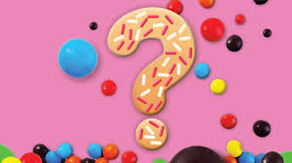
Quiz

Slide 3

Are people born clever?
Notes:
Discuss

Slide 4
Born with it?
Einstein's teacher said that he was “academically subnormal.”
Michael Jordan's coach said that he “wasn’t more talented than other people.”
Walt Disney was told that he lacked “creative imagination.”
Notes:
Does anyone know of anymore examples?

Slide 5
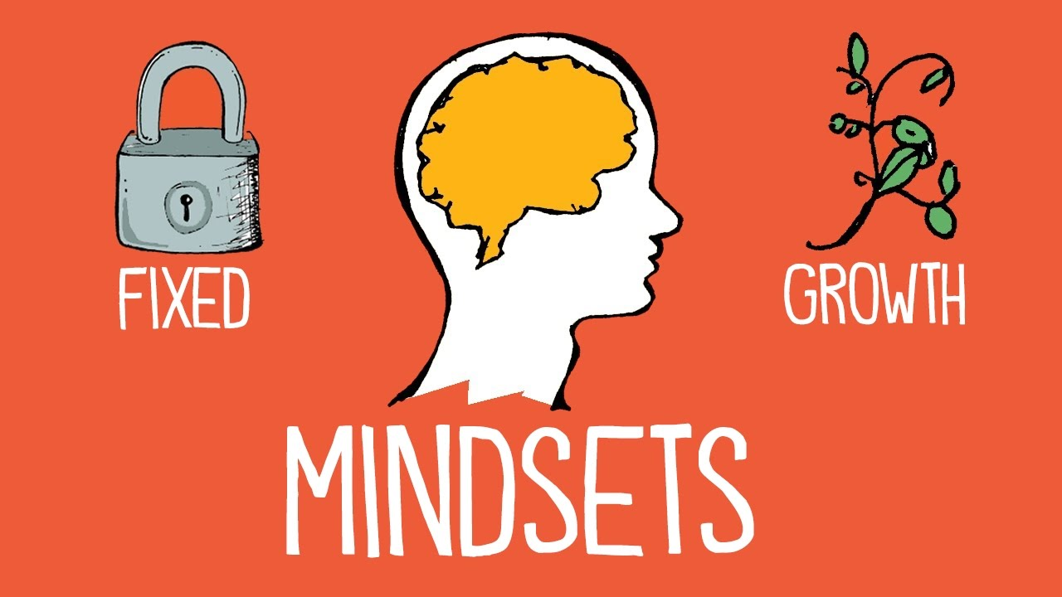
The research of Carol S. Dweck
Belief about ability
Affects decisions related to learning
Fixed mindset: intelligence and ability are fixed traits and there is very little you can do to improve it.
Growth mindset: intelligence and ability can be developed
Notes:
Intelligence is a malleable quality to be developed
The hand you are dealt is just a starting point for development.
Everyone can change and grow through application and experience
A persons true potential is unknown and unknowable
She argues that about 20% of learners are in the middle of these extremes and the rest are equally divided between the 2 extremes.
She categorises the extremes into
FIXED MINDSETS: intelligence is static and
GROWTH MINDSETS: intelligence can be developed

Slide 6
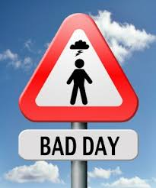
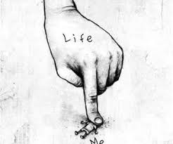
Imagine...
What would you think?
What would you feel?
What would you do?
Notes:
Young adult having a really bad day
Go to a class that is really important to you and you like a lot. The teacher gives back a test paper you have done. You got a C+
That evening you go back to your car and find you have a parking ticket.
You call your best friend to share your experience and are sort of brushed off
Fixed mindset said: feel like a reject, total failure, loser, worthless and dumb, everyone’s better than me – see what happened as direct measure of their competence and worth. See lives as pitiful, world is out to get me, nobody loves me, life is unfair and all efforts are useless, i’m the most unlucky person on earth.
Just low self esteem or pesimists? When they aren’t coping with failure feel just as worthy and optimistic as people with a growth mindset.
How do they cope? Not bother putting so much effort in again, yell at someone, break something, do nothing, give up.
But nothing catastrophic or irreparable has happened.
How do people with GM think? I need to try harder in class, be more careful when parking the car, find out what’s bothering my friend
How do they cope? Directly. Studying harder or in a different way, pay the ticket, work things out with my friend next time we speak.
GM do not label themselves – feel distressed but ready to take risks, confront challenges and keep working at them
FM – risk and effort might reveal inadequacies and show you were not up to the task.
The view you adopt for yourself profoundly effects the way you live your life.
Fixed mindset – urgency to prove yourself over and over so don’t look or feel deficient
Alfred Binet – designed tests to identify children who were not profitting from Paris schools so that educational programmes could be designed to get them back on track.
OUR BELIEFS AFFECT OUR THINKING AND ACTIONS

Slide 7
Dweck’s research: transition to 7th grade
Work gets harder, kids begin to struggle
Assessed whether students with identical achievement scores at the beginning of 7th grade had fixed or growth mindsets
Fixed mindset students were focused on grades.
Growth mindset students said learning was more important than getting good grades.
Math grades rose dramatically in the growth mindset group as compared to the fixed mindset group.
Notes:
Equivalent to Year 8

Slide 8
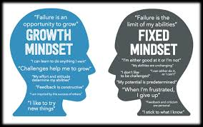

Slide 9
If you believe in a fixed mindset
Success/ achievement should come naturally. If I have to work hard then I’m not very smart.
Hide mistakes and conceal deficiencies.
Tend to create PERFORMANCE goals.  They believe that a person’s POTENTIAL can be MEASURED. They aim to receive validation from others. Receiving low marks mean that they are not smart. Both success and failure cause ANXIETY.
Fixed mindset students have no recipe for recovering from failure, and instead tend to:
Give up
Blame others or circumstances
Try to feel superior in some other way

Slide 10
If you believe in a growth mindset
Work hard. Effort is key!
Confront setbacks. Learn from mistakes.
Those with a growth mindset tend to create LEARNING goals.  The goal is MASTERY and COMPETENCE. Scores and marks reflect how people are doing NOW and do not measure a person’s potential.  Creating goals for learning has shown to INCREASE PERFORMANCE and enjoyment and decrease negative emotion.

Slide 11
Language
Our words tell students what we believe and what we value
What words and phrases would you associate with a growth mindset?
What language would you be using in your classroom?
Notes:
Beware of emphathising when this reinforces a fixed mindset
Discussion in small groups
Take feedback – create flip chart
Give further ideas – pg 26/27

Slide 12
Introducing growth mindset language
Create a wall display based around the words
Get students to create work (posters, guides, leaflets) based on the words
Use the words as part of the feedback you deliver, both written and verbal
Start a class game of ‘spot the example’
Model using the words in conversation

Slide 13
Reframing language
I can’t do it
I’ll never be able to do it
This isn’t me
I’m not an Art person
There’s no way I’ll ever be able to get the hang of this
Notes:
In each case these student’s words imply they have a fixed sum of intelligence which it is impossible to change.
We want to shift student language away from this by using reframing (not telling them directly they shouldn’t think like this):
Listen to what the student says
Consider how you could reframe the student’s words back to them so that they take on a different meaning
Speak the words to the student
If approrpiate draw the student’s attention to the difference between their initial words and your reframed version
Activity: in pairs try reframing these student statements
Other technique: ‘yet’

Slide 14
Metaphors and similes
Your brain is like a muscle – it gets stronger the more you use it www.classdojo.com
Feedback is your friend; it’s there to help you
Effort is a vector – it needs direction as well as size
Challenges are brain food
Mistakes are the building blocks of understanding

Slide 15
Praise
Praising intelligence makes children fragile.
Our tendency to praise able/successful children for their intelligence may actually be detrimental to their long-term intellectual growth and development.
Students praised for intelligence:
Selected easier tasks when given choice
Lied about their scores in an effort to look “smart”
Notes:
“Wow, you’re really smart! ” 
“Look at how well you did on this project. You are so intelligent!

Slide 16
Messages About Success
Listen for the messages in the following examples:
“You learned that so quickly! You’re so smart!”
“Look at that drawing. Martha, is he the next Picasso or what?”
“You’re so brilliant, you got an A without even studying!”
If you’re like most parents, you hear these as supportive,
esteem-boosting messages. But listen more closely. See if you can hear another message. It’s the ones that children hear:
“If I don’t learn something quickly, I’m not smart.”
“I shouldn’t try drawing anything hard or they’ll see I’m no Picasso.”
“I’d better quit studying or they won’t think I’m brilliant.”

Slide 17
Praise effort!
Students who were praised for effort:
Overwhelmingly (90%) chose more challenging tasks
Showed higher levels of engagement and achievement
Notes:
Pg 70

Slide 18
Providing feedback-based praise
Have a go at rewording the following examples of trait-based praise:
Great work from you – just as I would expect!
You’re amazing!
You’re so clever
I know a bright girl like you would get it right
Great answer, you little genius!
Notes:
Pg 70/71

Slide 19
Mistakes
Help students to perceive mistakes and failure as a useful part of the learning process
When learning something new it is to be expected that we will make mistakes
Putting the emotional experience of failure aside and looking objectively at what happened and why so that we can improve
Notes:
Discuss ways of doing this in the classroom
Suggestions:
Mistake quotas (pg 42)
Mistake discussions (pg 48)

Slide 20
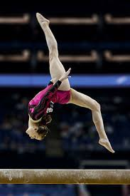
Elizabeth
Notes:
Nine-year-old Elizabeth was on her way to her first gymnastics meet. Lanky, flexible, and energetic, she was just right for gymnastics, and she loved it. Of course, she was a little nervous about competing, but she was good at gymnastics and felt confident of doing well. She had even thought about the perfect place in her room to hang the ribbon she would win.
In the first event, the floor exercises, Elizabeth went first. Although she did a nice job, the scoring changed after the first few girls and she lost. Elizabeth also did well in the other events, but not well enough to win. By the end of the evening, she had received no ribbons and was devastated.

Slide 21
Messages about failure
What would you do if you were Elizabeth’s parents?
Tell Elizabeth you thought she was the best.
Tell her she was robbed of a ribbon that was rightfully hers.
Reassure her that gymnastics is not that important
Tell her she has the ability and will surely win next time.
Tell her she didn’t deserve to win.
Notes:
There is a strong message in our society about how to boost children’s self-esteem, and a main part of that message is: Protect them from failure ! While this may help with the immediate problem of a child’s disappointment, it can be harmful in the long run. Why?
Let’s look at the five possible reactions from a mindset point of view [and listen to the messages:]
The first (you thought she was the best) is basically insincere. She was not the best – you know it, and she does too. This offers her no recipe for how to recover or how to improve.
The second (she was robbed) places blame on others, when in fact the problem was mostly with her performance, not the judges. Do you want her to grow up blaming others for her deficiencies?
The third (reassure her that gymnastics doesn’t really matter) teaches her to devalue something if she doesn’t do well in it right away. Is this really the message you want to send?
The fourth (she has the ability) may be the most dangerous message of all. Does ability automatically take you where you want to go? If Elizabeth didn’t win this meet, why should she win the next one?
The last option (tell her she didn’t deserve to win) seems hardhearted under the circumstances. And of course you wouldn’t say it quite that way. But that’s pretty much what her growth-minded father told he.

Slide 22
How to motivate learners to develop a growth mindset
Intelligence: demonstrate that it is isn’t fixed
Potential: full potential can only be reached through constant learning.
Validation: show the learner they can become whoever they wish to be.
Challenge: get them to welcome challenge and be willing to take reasonable risks to overcome and improve.
Learning: get them to value learning for what it will do for them.
Notes:
Intelligence can be developed through hard work and the accumulation of knwoeldge and understanding.
Validation – and should never have to justify themselves to others.
Growth mindset learners are motivated by an inner desire to improve rather than by external stimuli.
As teachers, we often assume that learning will inevitably lead to achievement and is, therefore, worth the effort. According to a number of research reports, nearly half of learners at all levels don’t share this view.

Slide 23
How to motivate learners to develop a growth mindset
Praise effort as much as you praise results
Don’t make praise person-centred – success comes from hard work
Don’t allow learners who fail to consider themselves to be a failure. Get them to analyse what went wrong and put it right next time.
Emphasise that knowledge and skills can be cultivated and that effort is required for learning.
Notes:
‘you really tried hard there’ rather than ‘you’re naturally good at this’

Slide 24
How to motivate learners to develop a growth mindset
Make use of analogies, metaphors and role models to demonstrate what can be achieved through hard work and effort.
Don’t allow learners to blame the teacher or the task for their failure. Get them to reflect on the effort they put in or the strategies they adopted to prepare for learning. Encourage use of self-assessment and peer assessment.
Convince your learners that every setback is a challenge and that every challenge is an opportunity to improve.

Slide 25
What will you do next?
Spend a few minutes of reflection, either on your own, or with a partner.
What will you start doing?
What will you do more of?
What will you stop doing?
‘Doing’ could be re-read as ‘saying’
Write your ideas down.

Slide 26
References
Brummelman, E., Thomaes, S., Orobio de Castro, B., Overbeek, G., & Bushman, B. J. (2014). “That’s Not Just Beautiful--That's Incredibly Beautiful!”: The Adverse Impact of Inflated Praise on Children With Low Self-Esteem. Psychological Science, 25(3), 728–735. doi:10.1177/0956797613514251
Brummelman, E., Thomaes, S., Overbeek, G., Orobio de Castro, B., van den Hout, M. A., & Bushman, B. J. (2014). On feeding those hungry for praise: Person praise backfires in with low self-esteem. Journal of Experimental Psychology: General, 143(1), 9-14. doi:10.1037/a0031917
Dweck, C. S. (2012) Minset: How You Can Fulfil Your Potential. London: Robinson
Gershon, M. (2016). How to develop growth mindsets in the classroom: The complete guide.
Mueller, C & Dweck, C. (1998). Praise for Intelligence Can Undermine Children's Motivation and Performance . Journal for Personality and Social Psychology, 75(1), 33-52

